Slide 1
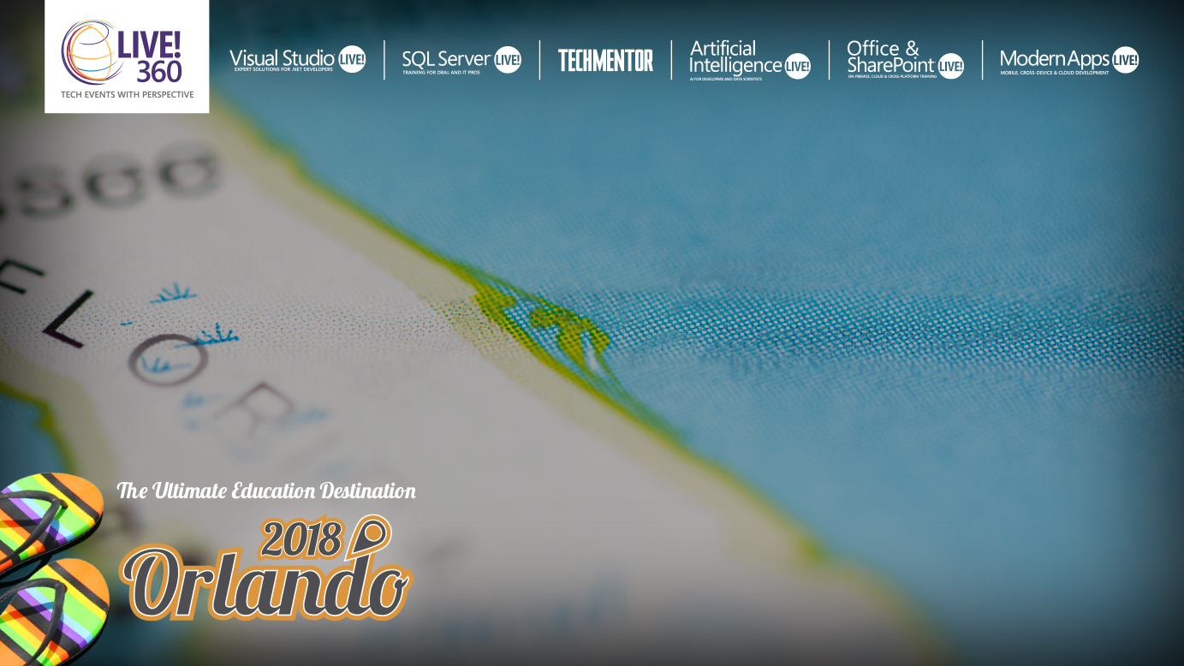
Introduction to SQL Server Essential Concepts
Bradley Ball
Sr. Azure Engineer,
Microsoft
Level: Intermediate

Slide 2


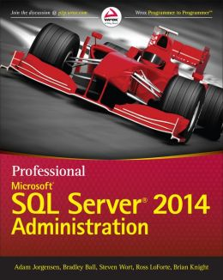
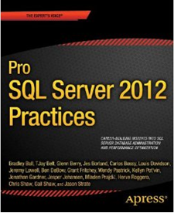
Speaker Introduction: Bradley Ball
Currently Sr. Azure Engineer FastTrack CXP Microsoft
Over 15 Years IT Experience, Former Microsoft MVP
Previous experience DBA, for the U.S. Army, The Executive Office of the President, Sr. SQL DBA Staff Specialist at Publix, Data Platform Practice Manager for Pragmatic Works
Pro SQL Server 2012 Practices Author
Chapter 14 PAGE & ROW COMPRESSION!
Managing Author on Pro Admin 2014 Guide

Slide 3

IT Experts Learn SQL Backwards

Slide 4

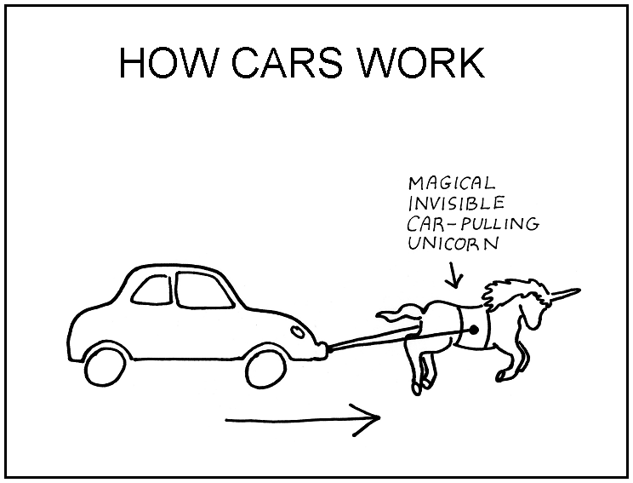



Learning Backwards: How SQL Works
Database
V
Tables
Views
Clustered Indexes
Non-Clustered Indexes

Slide 5
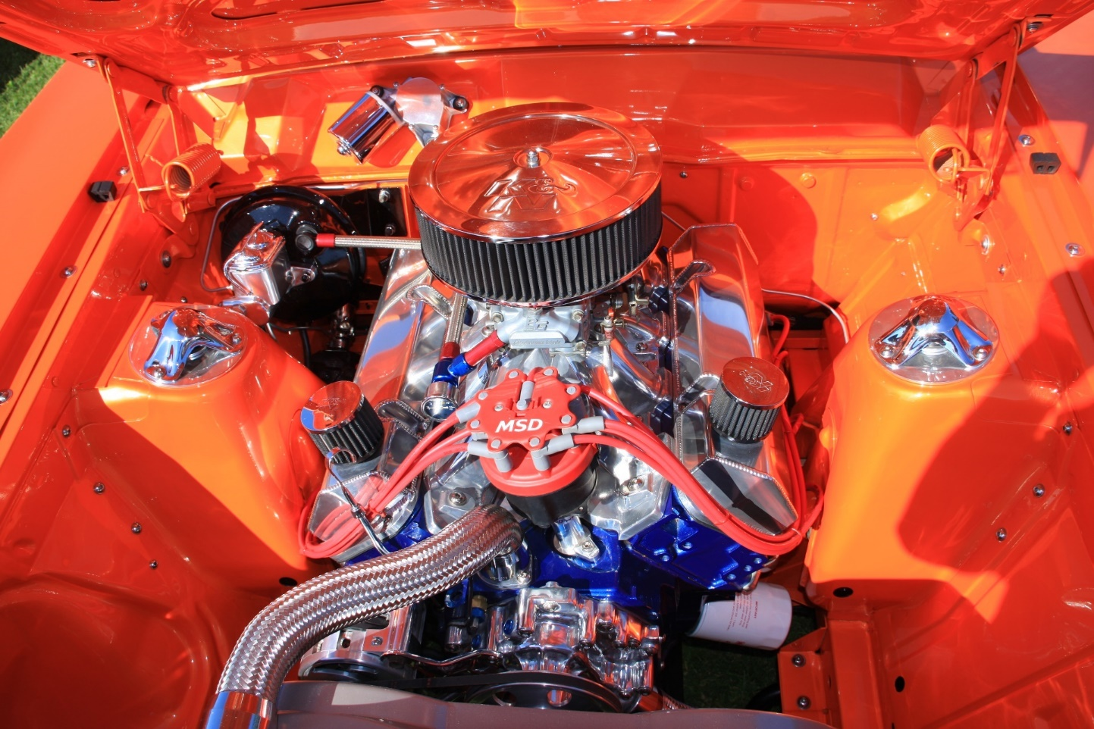
Why Learn the Internals

Slide 6

ACID
Atomicity
Consistency
Isolation
Durability

Slide 7
Transaction Isolation Levels
Serializable
Read Committed
Read Uncommitted
Repeatable Read
Snapshot Isolation
SQL Server Default
SQL Database Default

Slide 8

Demo

Slide 9
SQL 2012 and below: Select
Relational Engine
SNI
USER
Command
Parser
Optimizer
Query
Executor
Buffer Pool
Storage Engine
Plan Cache
Transaction
Manager
Access
Methods
Buffer
Manager
Data Cache
DATA on Disk
DATA
SQL OS
Notes:
Discuss the SNI, Relational Engine, Storage Engine, and SQL OS

Slide 10
On The Inside: In-Memory OLTP
In-Memory
Store
SNI
Relational Engine
Classic
Query Executor
Command
Parser
In-Memory SP’s and Schema
In-Memory Query Executor
Query
Executor
Optimizer
Buffer Pool
Query
Interop
In-Memory Data
Storage Engine
Plan Cache
Memory Optimized Tables and Indexes
Transaction
Manager
Access
Methods
Buffer
Mngr
Data Cache
DATA
IN-Memory
Data
*Loaded on Start up
DATA
SQL OS

Slide 11
SQL OS
Pre-emptive Scheduling
Cooperative Pre-emptive Scheduling

Slide 12
Locks, Latches, Waits
Locks (like a stop light)
Row, Page, and Table Escalation
Latches (like - who watches the locks/’watchmen’)
Locks for Locks
Waits Cooperative Scheduling
Giving up our place in line willingly

Slide 13
Linux
Oh Wait, You thought you just needed to understand Windows?

Slide 14
SQL 2017 – Linux
Linux Process
SQLPAL managed
Software isolated process
SQL Server
Windows Calls (+1200)
SQLPAL
ABI Calls (50)
Linux Host Extension
Linux OS Calls
Linux OS

Slide 15
Azure SQL Database
SQL Database
Elastic Pools
SQL Managed Instance

Slide 16
What’s available on Linux?
Operational features
Support for RHEL, Ubuntu, SLES, Docker
Package-based installs
Support for OpenShift, Docker Swarm
Failover clustering via Pacemaker
Backup/Restore
SSMS on Windows connected to Linux
Command-line tools: sqlcmd, bcp
Transparent Data Encryption
Backup Encryption
SCOM Management Pack
Dynamic management views
Table partitioning
SQL Server Agent
Full-Text Search
Integration Services
Active Directory integrated authentication
TLS for encrypted connections
Notes:
SQL Server on Linux aims to support the core relational database engine capabilities.
In general, our goal is “it’s just SQL Server.”
95% of features just work – anything app or coding related
Some features have partial support – e.g. SQL Server Agent isn’t going to launch a windows command prompt
Some features are in progress
Some features we’ll never support – e.g. FileTable, where you have a win32 share to place files that show up in the engine – the next slide contains more details
And while it’s the same SQL Server that you may (or may not!) be used to, we’re putting in a lot of effort to be a good Linux citizen.
Callouts:
Package-based installs – no “crappy installers” like predicted on Twitter; if SQL is coming to Linux, we’re going to do it right
Failover Clustering – resilience against OS/SQL failures; automatic failover within seconds
Log Shipping – warm standbys for DR
Xplat CLI – sqlcmd lets you connect/query from any OS; bcp lets you bulk copy data;
In-Memory – 30-100x performance increases by keeping tables in-memory and using natively compiled queries
ColumnStore – why SQL Server is the leader in Gartner’s Magic Quadrant for Data Warehousing, holds the top 3 slots in performance benchmark
Always Encrypted – protect your most sensitive data even from high-privileged database administrators
AD authentication – no need to manage separate credentials for SQL Server on Linux (https://docs.microsoft.com/en-us/sql/linux/sql-server-linux-active-directory-authentication)

Slide 17
What’s available on Linux?
Programming features
All major language driver compatibility
In-Memory OLTP
Columnstore indexes
Query Store
Compression
Always Encrypted
Row-Level Security, data masking
Auditing
Service Broker
CLR
JSON, XML
Third-party tools
Notes:
SQL Server on Linux aims to support the core relational database engine capabilities.
In general, our goal is “it’s just SQL Server.”
95% of features just work – anything app or coding related
Some features have partial support – e.g. SQL Server Agent isn’t going to launch a windows command prompt
Some features are in progress
Some features we’ll never support – e.g. FileTable, where you have a win32 share to place files that show up in the engine – the next slide contains more details
And while it’s the same SQL Server that you may (or may not!) be used to, we’re putting in a lot of effort to be a good Linux citizen.
Callouts:
Package-based installs – no “crappy installers” like predicted on Twitter; if SQL is coming to Linux, we’re going to do it right
Failover Clustering – resilience against OS/SQL failures; automatic failover within seconds
Log Shipping – warm standbys for DR
Xplat CLI – sqlcmd lets you connect/query from any OS; bcp lets you bulk copy data;
In-Memory – 30-100x performance increases by keeping tables in-memory and using natively compiled queries
ColumnStore – why SQL Server is the leader in Gartner’s Magic Quadrant for Data Warehousing, holds the top 3 slots in performance benchmark
Always Encrypted – protect your most sensitive data even from high-privileged database administrators

Slide 18
Features not currently supported on Linux
Database Engine
Transactional replication
Merge replication
Stretch DB
PolyBase
Distributed query with third-party connections
System extended stored procedures (XP_CMDSHELL, etc.)
Filetable
CLR assemblies with the EXTERNAL_ACCESS or UNSAFE permission set
Buffer Pool Extension
SQL Server Agent
Subsystems: CmdExec, PowerShell, Queue Reader, SSIS, SSAS, SSRS
Alerts
Log Reader Agent
Change Data Capture
Managed Backup
Services
SQL Server Browser
SQL Server R Services
StreamInsight
Analysis Services
Reporting Services
Data Quality Services
Master Data Services
High Availability
Database Mirroring
Security
Extensible Key Management
Notes:
NB: This slide is correct as at SQL Server 2017 RC2. The list of unsupported features might change in later releases.
For more information, see: https://docs.microsoft.com/en-us/sql/linux/sql-server-linux-release-notes.

Slide 19
SQL Server on Linux investment roadmap
SQL Server Agent transaction replication ​
Machine Learning Services in R & Python
PolyBase on Linux
HA on Containers and Kubernetes
AD authentication for linked servers and AGs
Distributed Transactions (DTC)​
3rd party AD tools like Centrify

Slide 20


What Did We Just Cover
SQL Internal Components

Slide 21
SQL Data Hierarchy
IAM Chains and Allocation Units
Allocation Bit Maps
Extents
Pages
Records

Slide 22

What in the Shire Do Hobts Have to Do With My Data?!
Allocation Units are made of 3 types
IN_ROW_DATA
Also known as HoBTs
Stands for Heap or B-Trees
LOB_DATA
Also known as LOBs
Stands for Large Object Data
ROW_OVERFLOW_DATA
Also known as SLOBs
Small Large Object Data
Partitions

Slide 23

Heaps vs. Tables

Slide 24
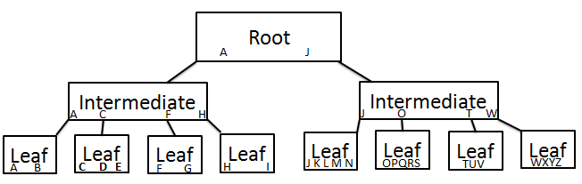
B-Tree

Slide 25
Demo

Slide 26
What Did We Just Cover
SQL Internal Components
Internal Storage Structures

Slide 27
Recovery Models
On Premise
Full
Bulk Logged
Simple
Terms
HA – High Availability
DR – Disaster Recovery
SLA – Service Level Agreement
RTO – Recovery Time Objective
RPO – Recovery Point Objective

Slide 28
Recovery Models In the Cloud
Full Recovery with constant Transaction Log Backups
Point in time recovery up to any time in backup retention
Retention depends on DB activity
Default capacity can be expanded, cost is Azure Storage
Terms
HA – High Availability
DR – Disaster Recovery
SLA – Service Level Agreement
RTO – Recovery Time Objective
RPO – Recovery Point Objective

Slide 29
Demo

Slide 30
What Did We Just Cover
SQL Internal Components
Internal Storage Structures
Recovery Models

Slide 31
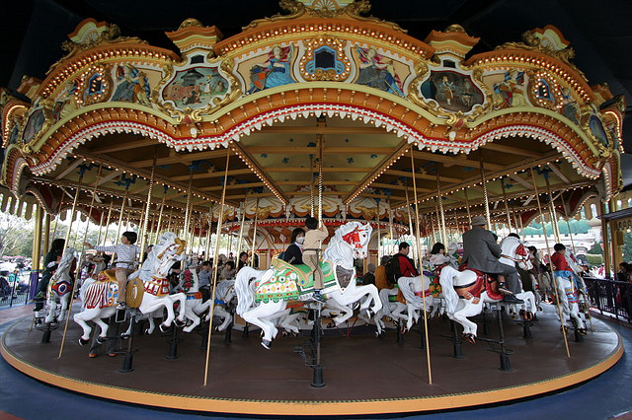
Transaction Log
http://www.flickr.com/photos/jo-ah-chim/2350979305/sizes/z/in/photostream/

Slide 32
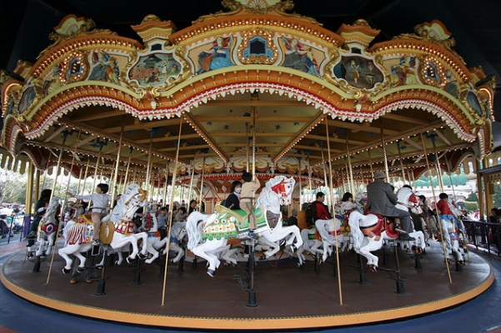
Transaction Log In Action In Simple Recovery
Virtual Log File
Notes:
Demo 03

Slide 33
Demo

Slide 34
Backups
Full
Transaction Log
Differential
FileGroup

Slide 35
Restores
Full
Differential
Transaction Log
Filegroup
Piecemeal
Page

Slide 36
Demo

Slide 37
What Did We Just Cover
SQL Internal Components
Internal Storage Structures
Recovery Models
Backup Types

Slide 38
Don’t Beat Yourself Up
Nobody Knows everything
Nobody can know everything
Do your best
Never stop learning

Slide 39
Additional Terms
Query data store
Do your best
Never stop learning

